Slide 1

SWE 425: Telecommunication Engineering
Md. Habibur Rahman
Lecturer, Dept. of Software Engineering

Slide 2
Cellular Communications

Slide 3
Worldwide Wireless:
Wireless devices
Mobile phones, cordless phones, remote controls, PDA, pager, laptop, iPAD PMP, MID, PND, UMPC
Wireless applications
Wireless internet, inventory management, games, credit card verification, e-mail, navigation, entertainment, payments …
Wireless technologies
GSM, WLAN, UMTS (3G), LTE, LTE/A. Bluetooth, Zigbee, WiMAX, microwave and many more

Slide 4
Why wireless?
No more cables
No cost for installing or rewiring – terminals anywhere
Communications can reach where wiring is not feasible or is too costly, e.g.. rural areas, old buildings…
Satellite communications has global coverage
Mobility and convenience
Allows users to access services whiling moving: walking, in vehicles, ships, planes…

Slide 5
Why wireless?
Flexibility
Roaming allows the flexibility to connect and stay connected anywhere and any time
Scalability
Much easier to expand network coverage compared to wired networks
Many other reasons
Ad hoc, emergency, battlefield……

Slide 6
Challenges of wireless communication:
Limited resources: finite radio spectrum
Supporting mobility
Location management, handoff between cells/networks
Maintaining Quality of Service (QoS) over unreliable wireless links
Radio path loss, shadowing, multipath fading, interference

Slide 7
Challenges of wireless communication:
Security
Wireless channels are open to interception & jamming
Certification, authentication, DRM
Mobile terminal battery life
Still an important constraint on equipment & services

Slide 8
Cellular Telephony:
Cellular telephony is designed to provide communications between two moving units called Mobile Stations (MSs).
It also provide communication between one mobile unit and one stationary unit, often called a land unit.
A service provider must be able to locate and track a caller, assign a channel to the call.

Slide 9
Cellular Telephony:
To make this tracking possible, each cellular service area is divided into small regions called Cells.
Each cell contains an antenna and is controlled by a network station, called the Base Station (BS).
Each base station, in turn, is controlled by a switching office, called a Mobile Switching Center (MSC).
It is a computerized center that is responsible for connecting calls, recording call information, and billing

Slide 10
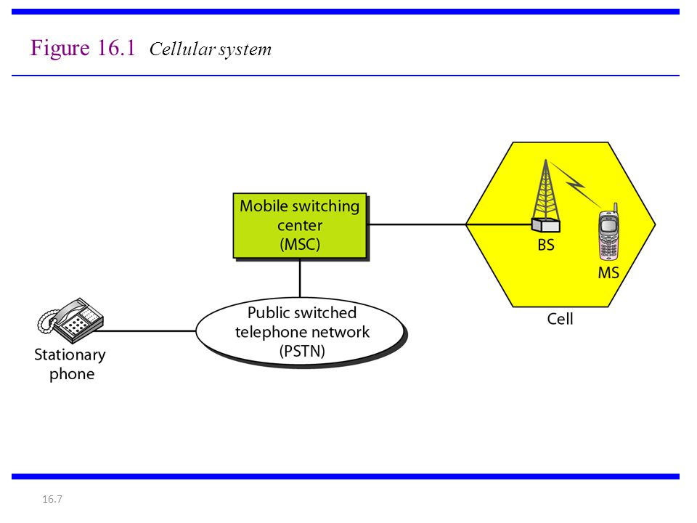
Cellular Telephony :

Slide 11
Cellular Communication Impairments:
Path loss
⇒ received power falls with distance
Shadowing ( slow fading )
⇒ caused by obstruction of buildings, hills, trees and foliage.
Multipath fading ( fast fading )
⇒ caused by multipath reflection of a transmitted wave by objects.
Delay spread, angular spread, Doppler spread, interference

Slide 12

Impairments:
shadowing
BS
path loss
multipath

Slide 13
Handoff (Handover):
During a conversation, the mobile station moves from one cell to another. When it does, the signal may become weak.
To solve this problem, the MSC monitors the level of the signal every few seconds.
If the strength of the signal diminishes, the MSC seeks a new cell that can better accommodate the communication.
This is called Handoff (Handover).

Slide 14
Guarantees the continuity of wireless services when the mobile user moves across the cell boundaries. Thus it handles user mobility
Maintains required QoS
Minimises interference level in the whole system by keeping the mobile linked to the strongest Node.

Slide 15
Types of Handoff
Hard Handoff :Early systems used a hard handoff. In a hard handoff, a mobile station only communicates with one base station. When the MS moves from one cell to another, communication must first be broken with the previous base station before communication can be established with the new one. This may create a rough transition.
Soft Handoff : New systems use a soft handoff. In this case, a mobile station can communicate with two base stations at the same time. This means that, during handoff, a mobile station may continue with the new base station before breaking off from the old one.

Slide 16
Reasons for Handoff
The signal between the current base station and the mobile may have deteriorated to such an extent that the call is in danger of being dropped,
A cell may have become overloaded, handling a large number of calls. This congestion may be alleviated by handing off mobiles to less congested nearby cells.

Slide 17
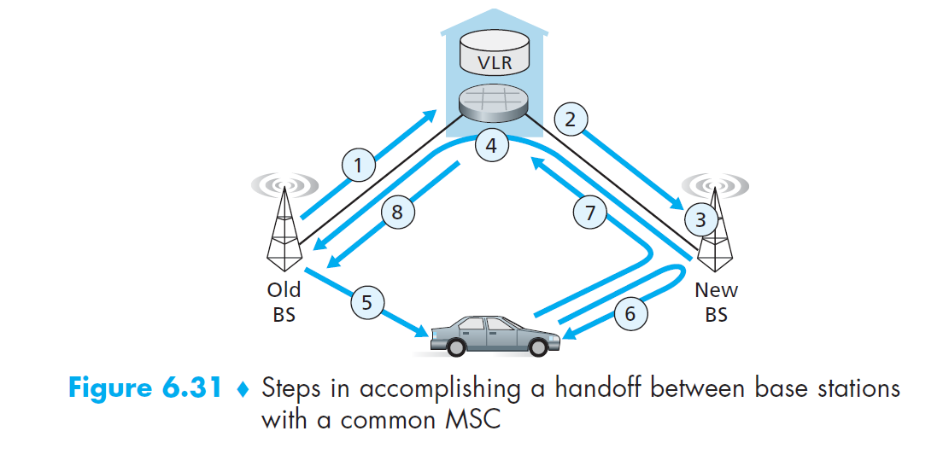
Step by Step Handoff Procedure

Slide 18
Step by Step Handoff Procedure
The old base station (BS) informs the visited MSC that a handoff is to be performed and the BS (or possible set of BSs) to which the mobile is to be handed off.
The visited MSC initiates path setup to the new BS, allocating the resources needed to carry the rerouted call, and signaling the new BS that a handoff is about to occur.
The new BS allocates and activates a radio channel for use by the mobile.
The new BS signals back to the visited MSC and the old BS that the visited-MSC-to-new-BS path has been established and that the mobile should be informed of the impending handoff. The new BS provides all of the information that the mobile will need to associate with the new BS.

Slide 19
Step by Step Handoff Procedure
The mobile is informed that it should perform a handoff. Note that up until this point, the mobile has been blissfully unaware that the network has been laying the groundwork for a handoff.
The mobile and the new BS exchange one or more messages to fully activate the new channel in the new BS.
The mobile sends a handoff complete message to the new BS, which is forwarded up to the visited MSC. The visited MSC then reroutes the ongoing call to the mobile via the new BS.
The resources allocated along the path to the old BS are then released.

Slide 20
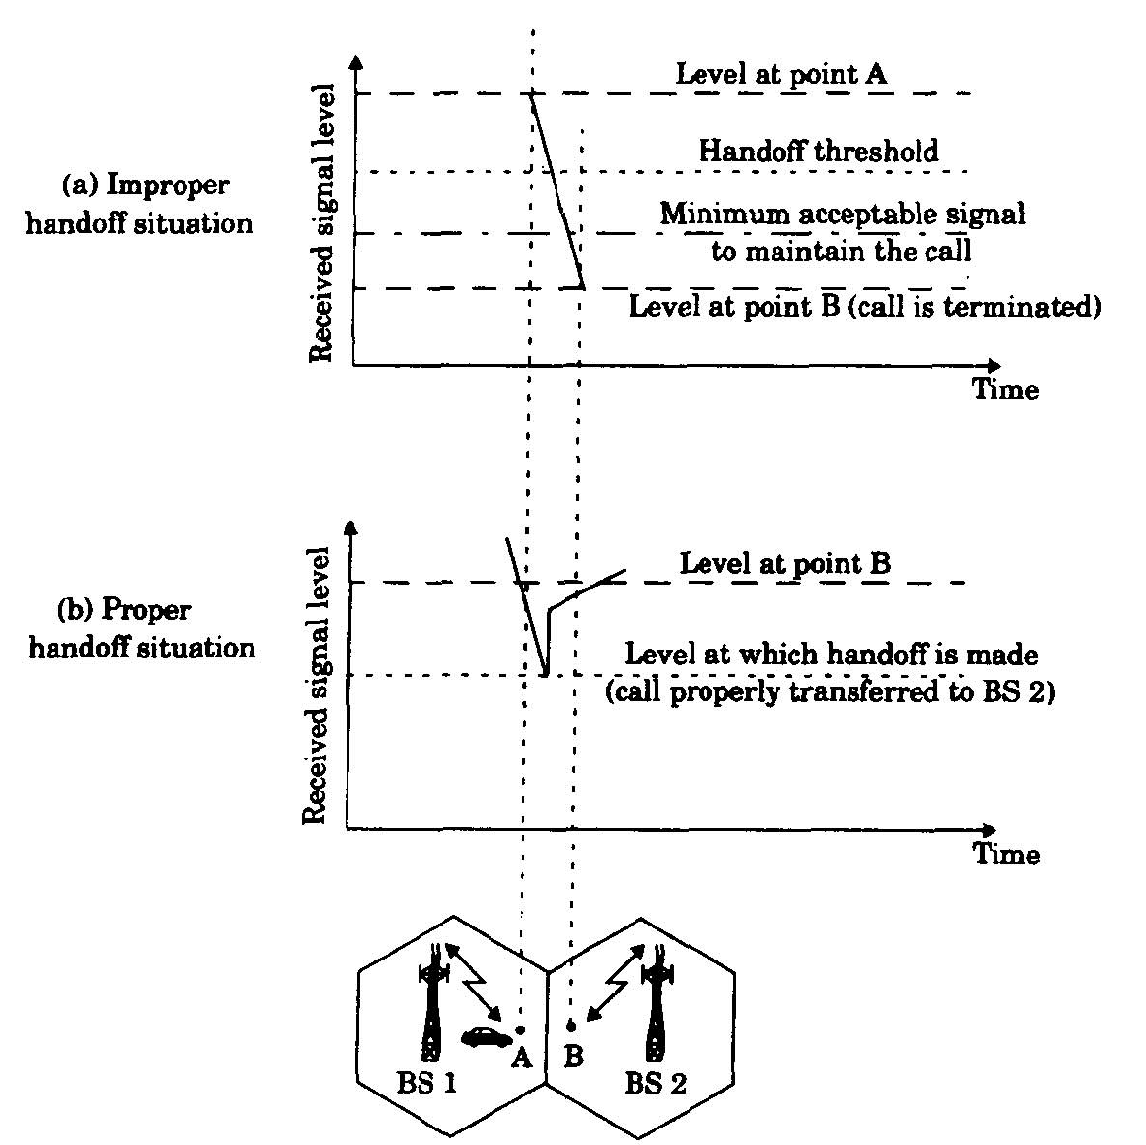
Handoff Strategies:

Slide 21
Frequency Reuse
Adjacent cells are assigned different frequencies to avoid interference or crosstalk
Cells sufficiently distant from each other can use the same frequency (frequency reuse)
Reuse factor N: number of cells in a repeating pattern
The number of cells per cluster, N, can only have values which satisfy:
N = i ² + ij + j ²
2
2
7
3
7
3
1
1
6
6
4
5
2
6
4
5
4
7
3
5
2
7
5
2
7
3
1
7
3
3
1
6
4
6
1
6
4
5
2
6
4
2
4
5
7
5
2
7
3
2
7
3
1
3
1
6
4
6
4
5
5
N=7
In practice each cell uses a set of frequencies and it is these that are repeated

Slide 22
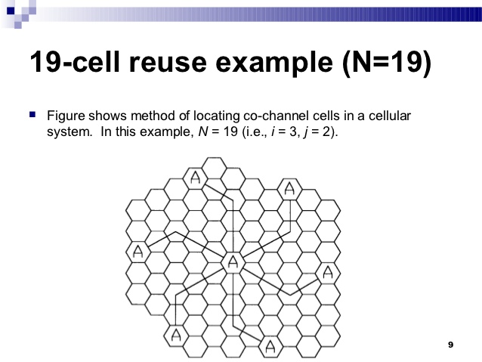

Slide 23
Frequency Reuse & System Capacity:
S = Number of duplex channels in the cellular system
K = Number of channels per cell
N = Number of cells (4, 7 or 12)
M = Number of times a cluster is repeatedly used
Available Channels per cell is:
K= S/N
The system capacity (total number of channels) in the system is:
C = M S = MNK

Slide 24
Calculate:

Slide 25
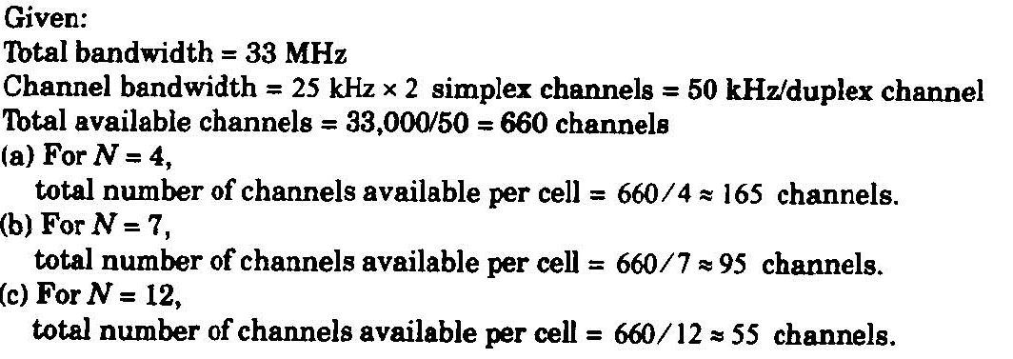
Solution:

Slide 26
How we make a Call:
To place a call from a mobile station, the caller enters a phone number and presses the send button.
The mobile station then scans the band and sends the data (phone number) to the closest base station using that channel.
The base station relays the data to the MSC.
The MSC sends the data on to the telephone central office.
If the called party is available, a connection is made

Slide 27
How we receive a Call:
When a mobile phone is called, the telephone central office sends the number to the MSC.
The MSC searches for the location of the mobile station by sending query signals to each cell in a process called paging.
Once the mobile station is found, the MSC transmits a ringing signal.
when the mobile station answers, assigns a voice channel to the call.
allowing voice communication to begin.

Slide 28
Thank You !!!
Any Questions ???

